Slide 1
TEXT TO SPEECH CONVERTER
Presented by
JOHN DAMILARE PELUMI
(Software Engineer)
ALX

Slide 2
TEXT TO SPEECH CONVERTER
INTRODUCTION
An application known as "text-to-speech" (TTS) translates text in a computer document, like a help file or web page, into spoken voice. TTS is useful for a variety of tasks, like improving text message reading comprehension or helping people with visual impairments access computer display information.
Voice-activated email and spoken prompts in voice response systems are two current uses for TTS.

Slide 3
TEXT TO SPEECH CONVERTER
A text-to-speech synthesizer is an application that translates text into spoken word. It does this by first utilizing Natural Language Processing (NLP) to analyze and process the text, and then Digital Signal Processing (DSP) technology to turn the text's processed form into a synthesized speech representation.
The NLP (Natural Language Processing) module: It generates both a prosodic and phonetic transcription of the text that is read.
The DSP (Digital Signal Processing) module: It creates understandable and audible speech out of the symbolic data it gets from NLP.

Slide 4
APPLICATION AREA OF TEXT TO SPEECH CONVERTER DESIGN
There are numerous uses for text-to-speech (TTS) converters in a variety of settings and businesses. Among the principal areas of application are:
Accessibility for Visually Impaired: Through the use of TTS technology, people who are blind or visually impaired can now read textual content on digital platforms like webpages, e-books, documents, and apps.
Education: Students that struggle with reading or have learning problems can benefit from the use of TTS converters. They have access to study resources, textbooks, and educational audio, all of which help improve learning objectives and comprehension.

Slide 5
APPLICATION AREA OF TEXT TO SPEECH CONVERTER DESIGN
Learning a language: TTS can help language learners become more proficient in comprehension, fluency, and pronunciation.
Navigation and GPS Systems: Turn-by-turn directions and other information are frequently given to drivers using TTS in navigation and GPS systems.
E-learning and Online Courses: Text-to-speech (TTS) is used by online courses and e-learning platforms to deliver audio versions of course content.
Entertainment and Media: Voice assistants, audiobooks, podcasts, and multimedia material all use text-to-speech technology. By giving entertainment platforms voice narration and interaction, it improves user experiences.

Slide 6
LEARNING OBJECTIVE OF THE DESIGN (TTS CONVERTER)
The main objective is creating an application that will help those who are non-verbal and blind communicate. This will be accomplished by integrating HTML, CSS, and JavaScript through the use of Code Editor software known as Visual Studio Code.
The goals we have for the design are as follows:
The aim is to offer assistance to nonverbal and blind individuals, such as providing them with appropriate communication methods.
2. Offering substitute ways to communicate, such speaking by typing.
3. To lessen the requirement that they rely on other people to understand their needs or communicate with them.
4. To further education and learning.

Slide 7
TECHNOLOGIES USED
To produce this TTS (text to speech converter app).
The HTML, CSS, and JavaScript files required to be created first.
We will use HTML to define the application's frontend during the development process. This will entail specifying the features and components that are required to make up the application, in addition to describing how the program will look visually.
Every single feature or component that is built will be styled using CSS. Improving the HTML elements' aesthetic appeal is its main goal.
The functionality of the program or system we are building will be defined using JavaScript. The behavior and response of the application to user interactions will be outlined.

Slide 8
TECHNOLOGIES USED
It is important to remember that HTML, CSS, and JavaScript code are needed for each of these procedures. Despite being written in different files, these codes are connected and kept in the same folder to allow for easy integration.
First, we obtain the user text in the JavaScript code and call the function textToSpeech(), supplying the user text as an input. I turned the entered text into speech inside this function by using the window object's speech synthesis feature. The web speech API called Speech Synthesis manages the speech service.
Next, we used Speech Synthesis' getVoices() method to retrieve every voice that was available from the user's device and inserted it into an HTML select tag.

Slide 9
THIRD SERVICES TECHNOLOGIES USED
THE ALGORITHM APPLIED THAT THE TTS CONVERTER
Our system reads the processed text using a model that is referred to as a machine learning algorithm. By establishing the relationships between phonemes and sounds, this system provides them with precise intonation.
Our method generates a vocal sound using a sound wave generator. The sound wave generator is ultimately fed phrases' frequency characteristics that were extracted from the acoustic model.

Slide 10
CHALLENGES ENCOUNTERED/ENVISIONED
The reason for starting this research was the difficulties visually challenged people have seeing the words they are typing clearly, even when they are accustomed to using a keyboard.
Their typed material eventually contains a significant amount of errors since they frequently assume that their input is accurate. Additionally, the struggles faced by nonverbal people—those who depend on others to understand their needs or messages—were another source of inspiration for us.

Slide 11
PROJECT TIMELINE - PLANNING DURATION
Week 1 – Brainstorming and planning
Week 2 – Designing and modification
Week 3 – Implementation and maintenance
Week 4 – Testing and presentation

Slide 12
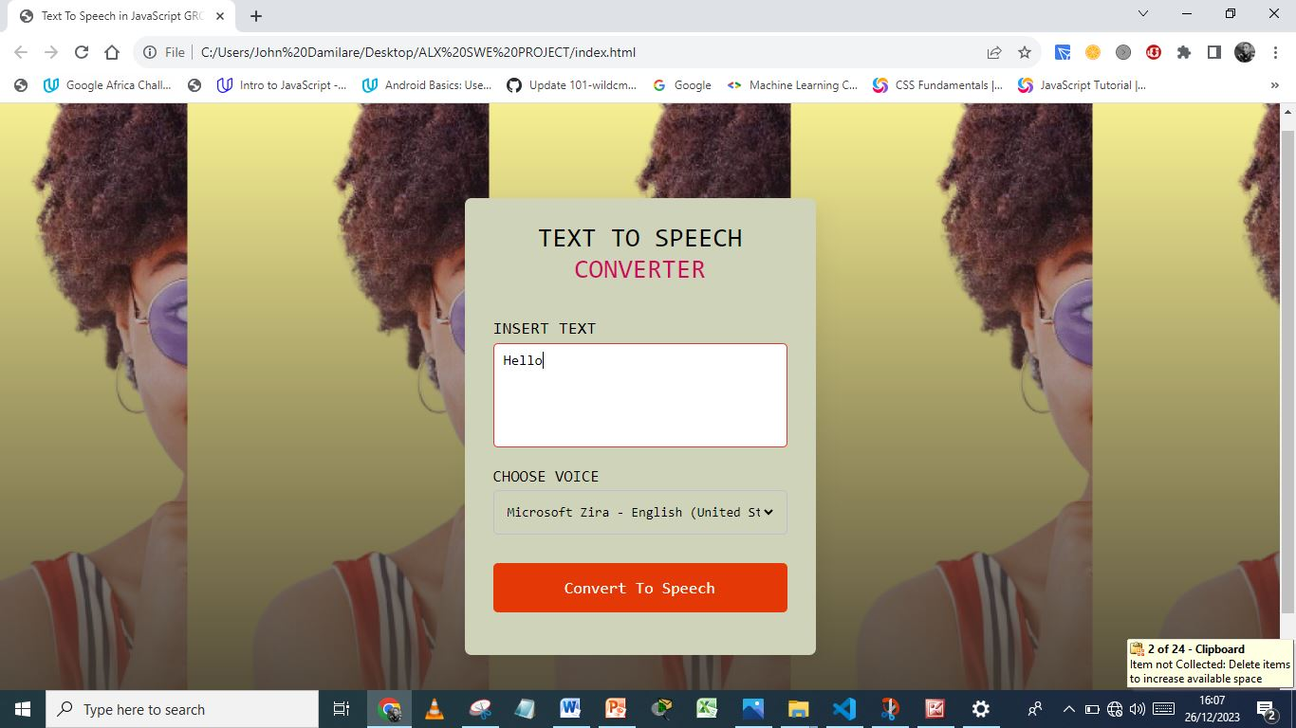
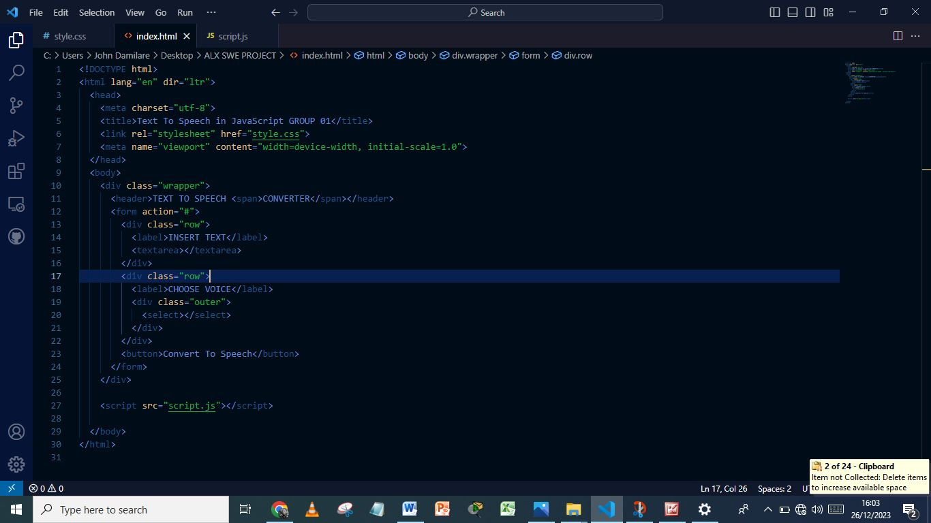
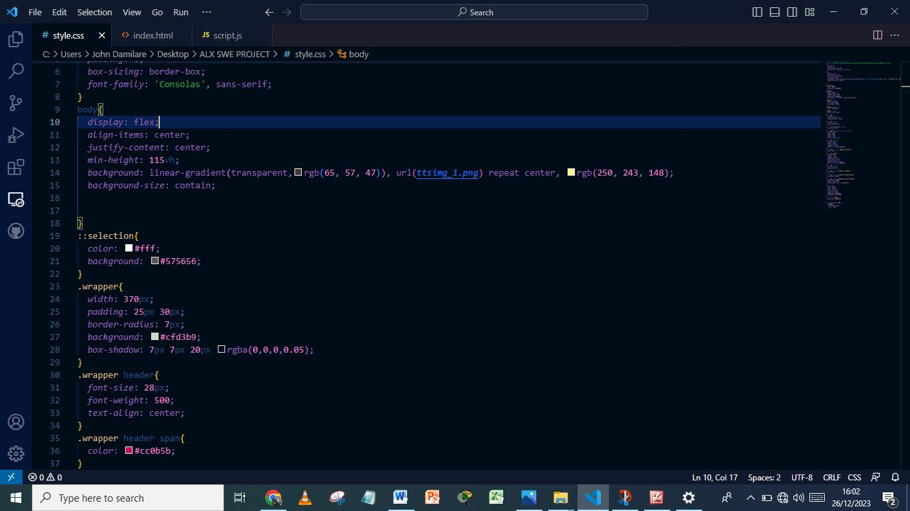
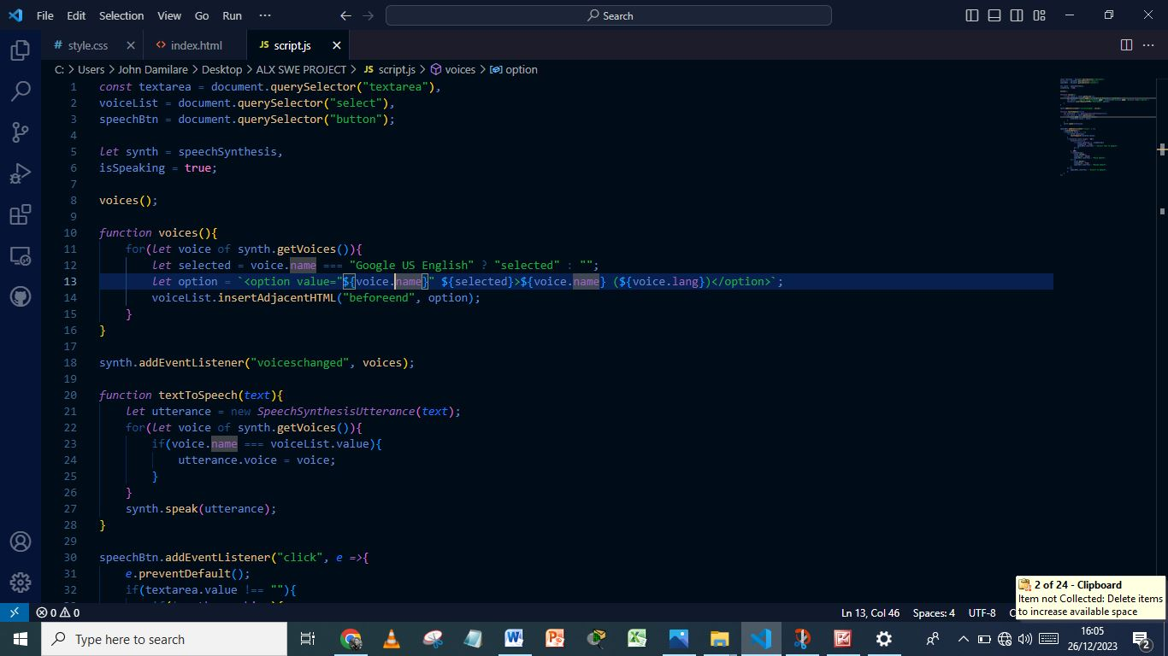
MOCK-UPS
The text to speech converter's final design is seen here.
The pseudo code we used for our HTML is shown here.
This is the pseudo code that we applied to our CSS
This is the pseudo-cde that we employed in our JavaScript

Slide 13
CONCLUSION
To sum up, text-to-speech converters are necessary devices that make it possible to convert written material into spoken language.
They find use in many different contexts, including as improving accessibility for those who are nonverbal and have visual impairments, as well as powering voice assistants, language learning programs, and content production platforms.

